Slide 1
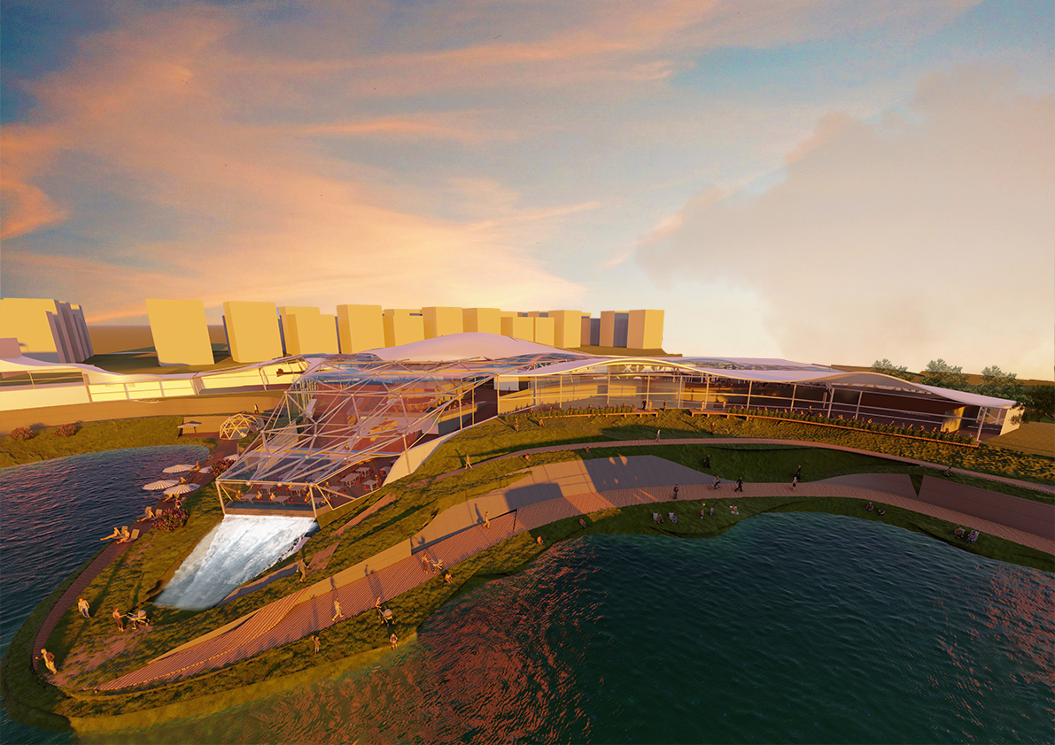
Eskişehir Aquatic Facility & Life Experience Center

Slide 2
Site Analysis

Slide 3
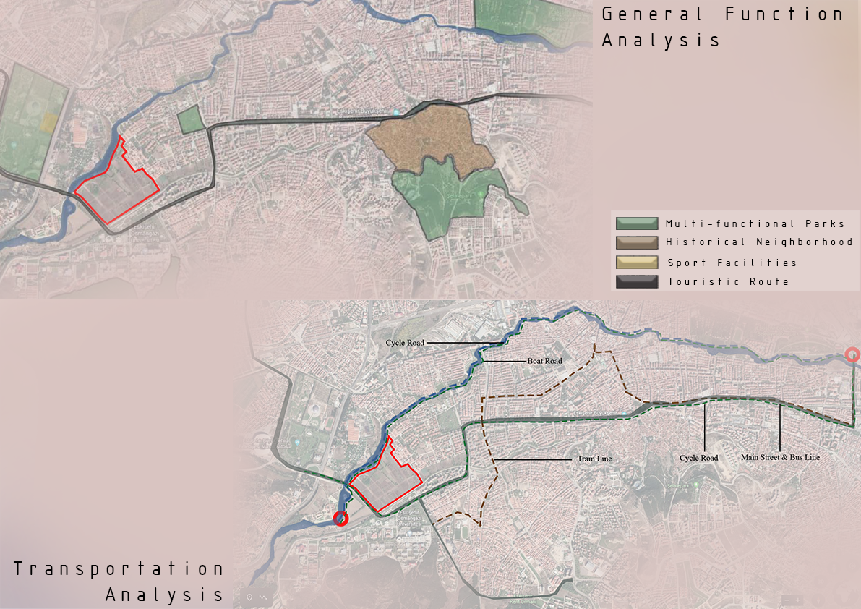

Slide 4
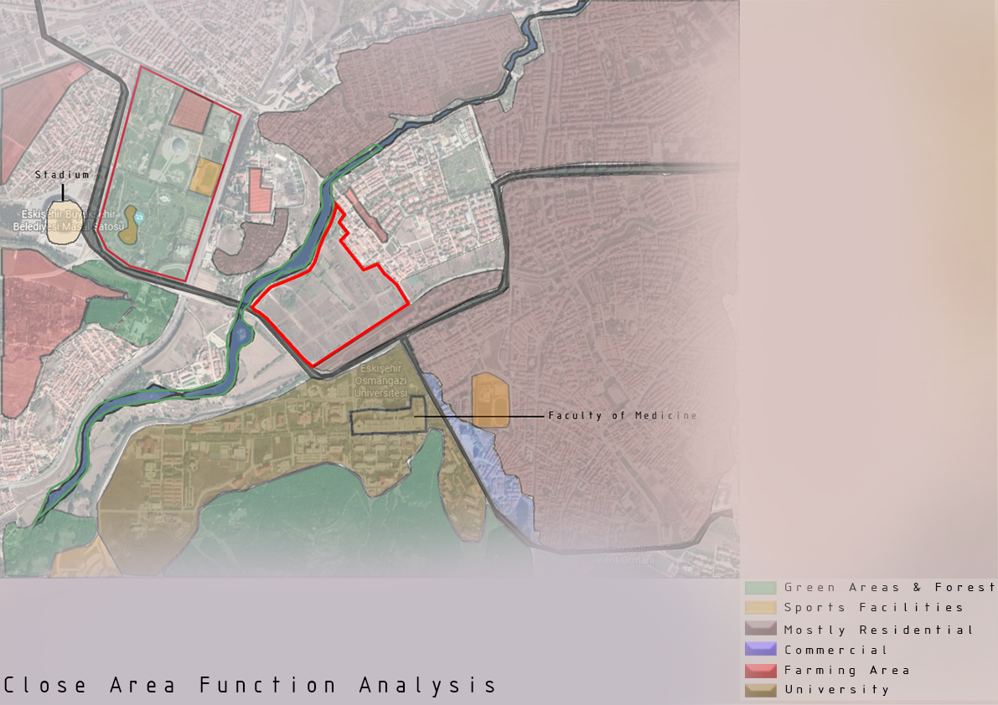

Slide 5
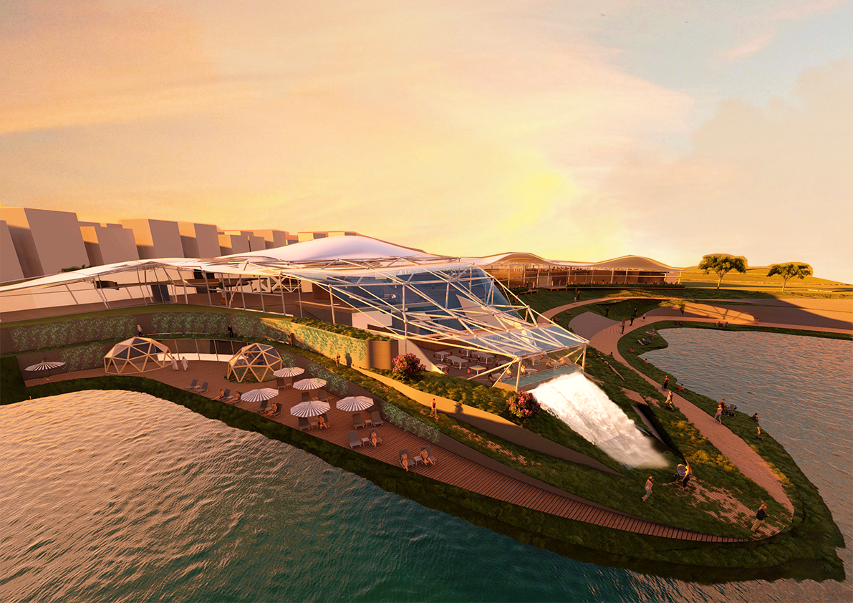

Slide 6
Master Plan & Programming

Slide 7
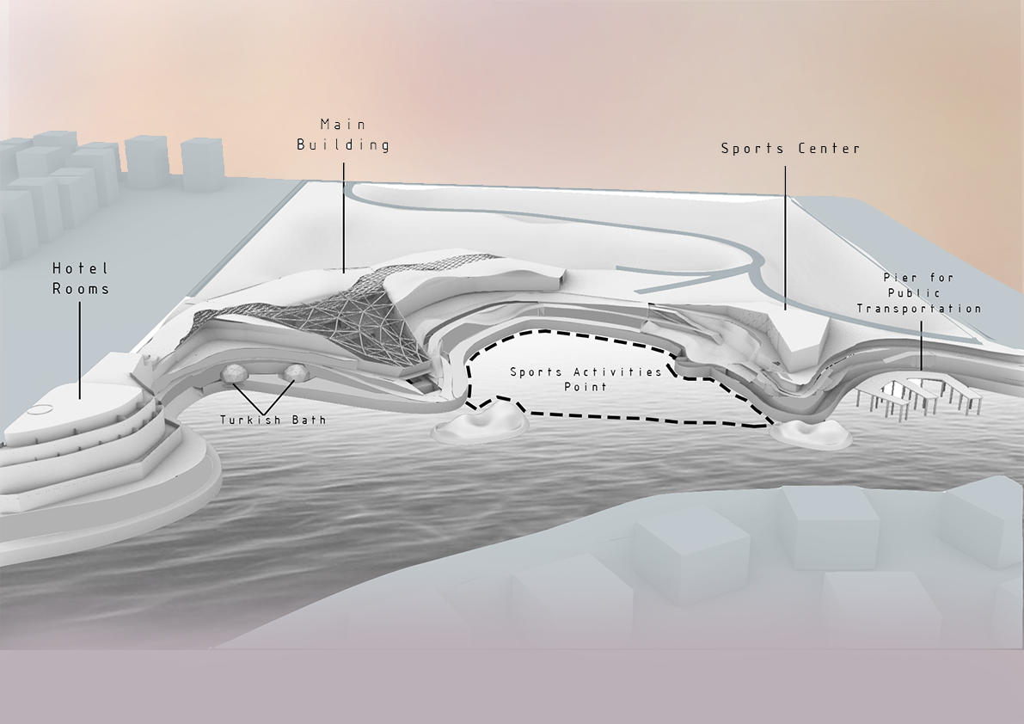
Master Plan
Master Plan

Slide 8
Programming

Slide 9
Circulation

Slide 10
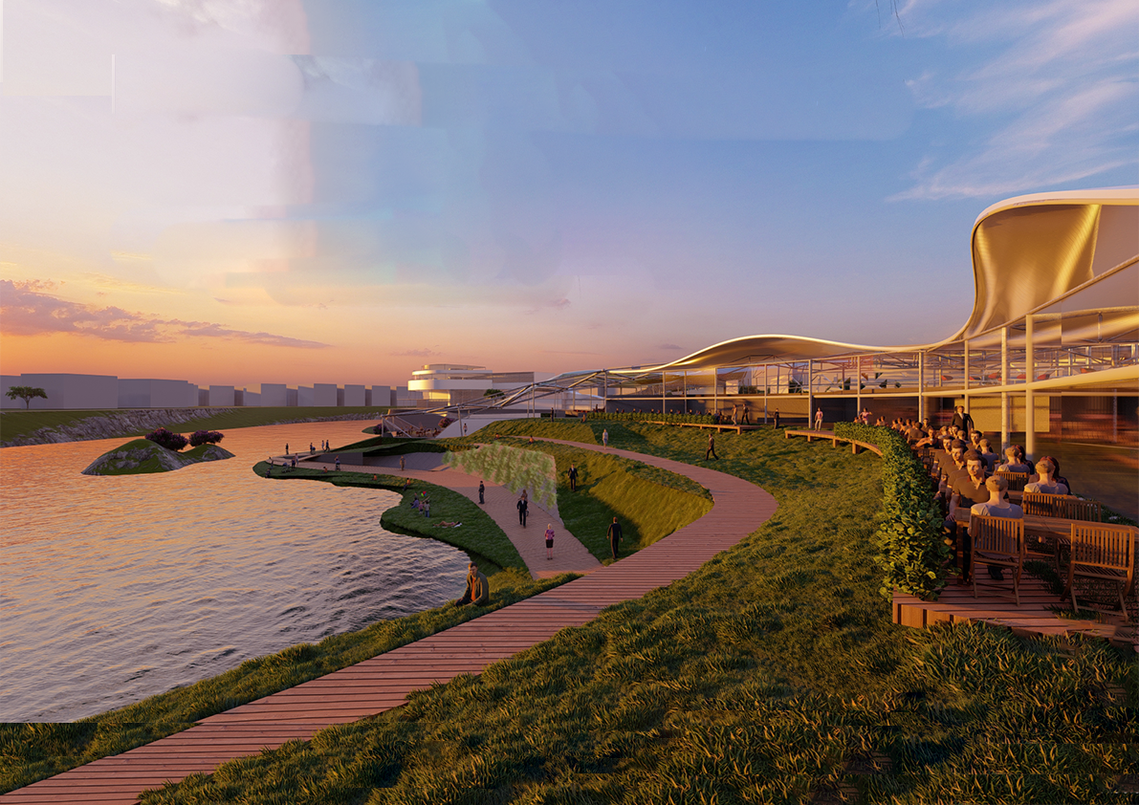

Slide 11
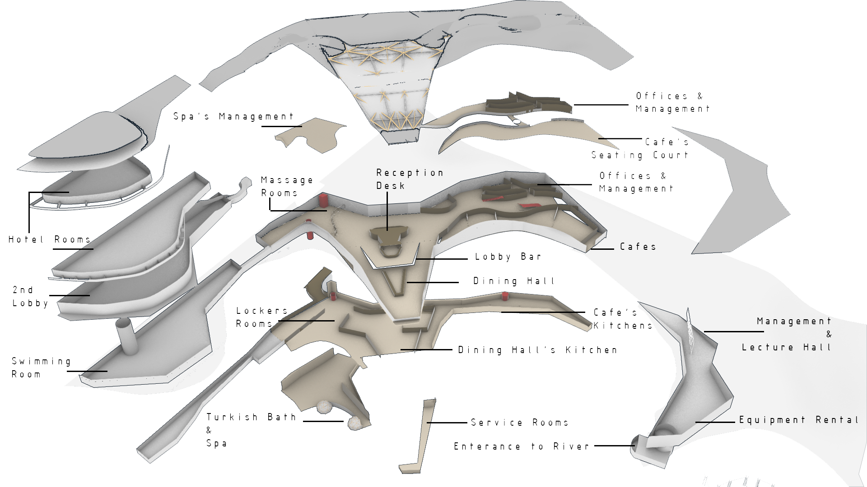
Exploded Plan

Slide 12
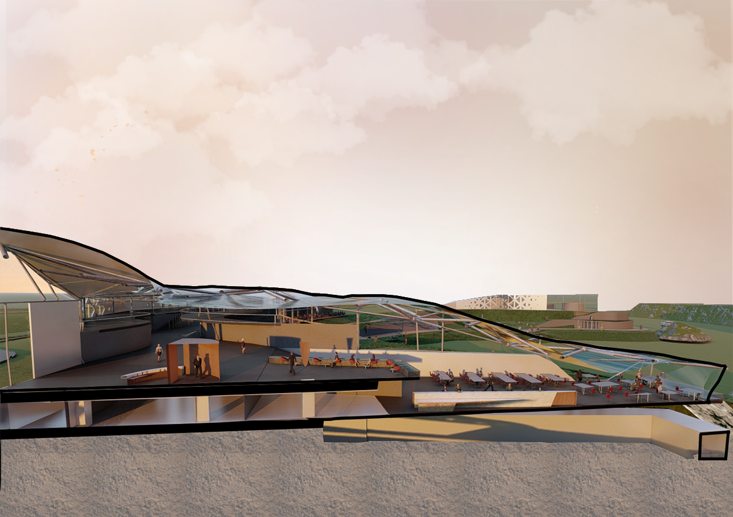

Slide 13
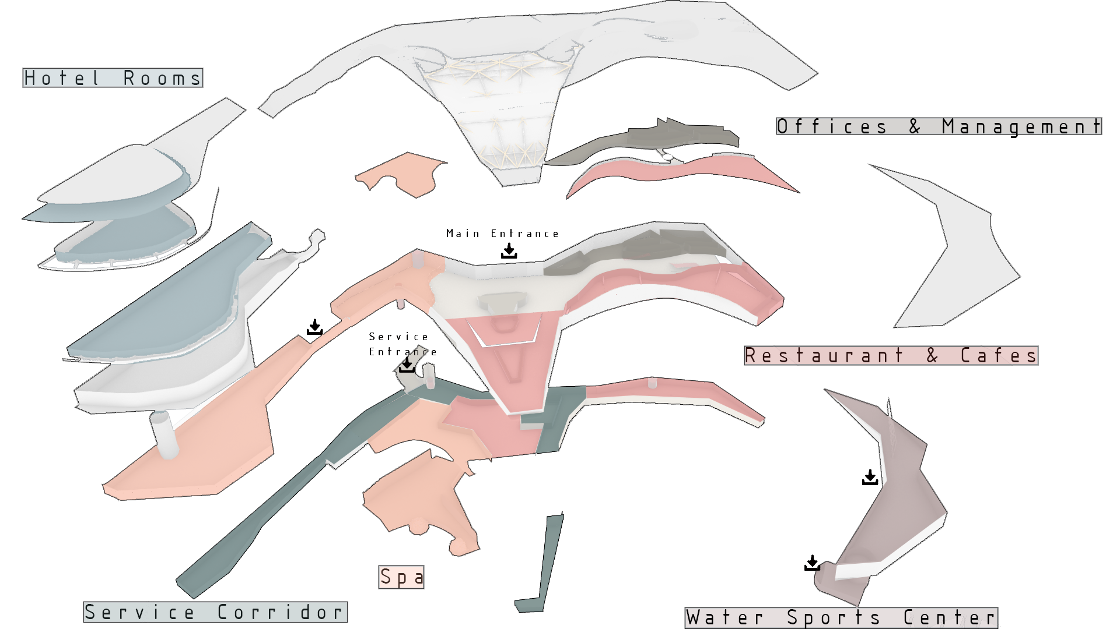
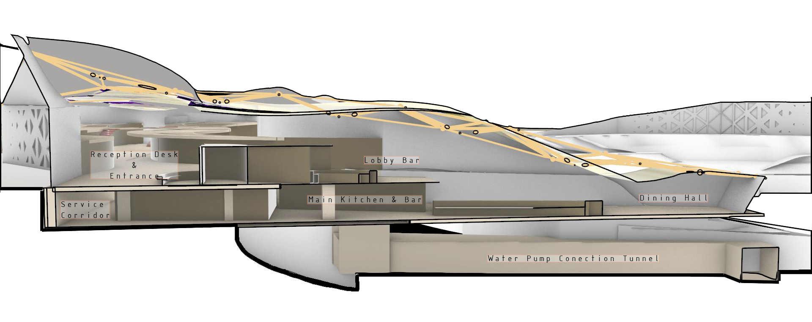
Function
Diagrams

Slide 14
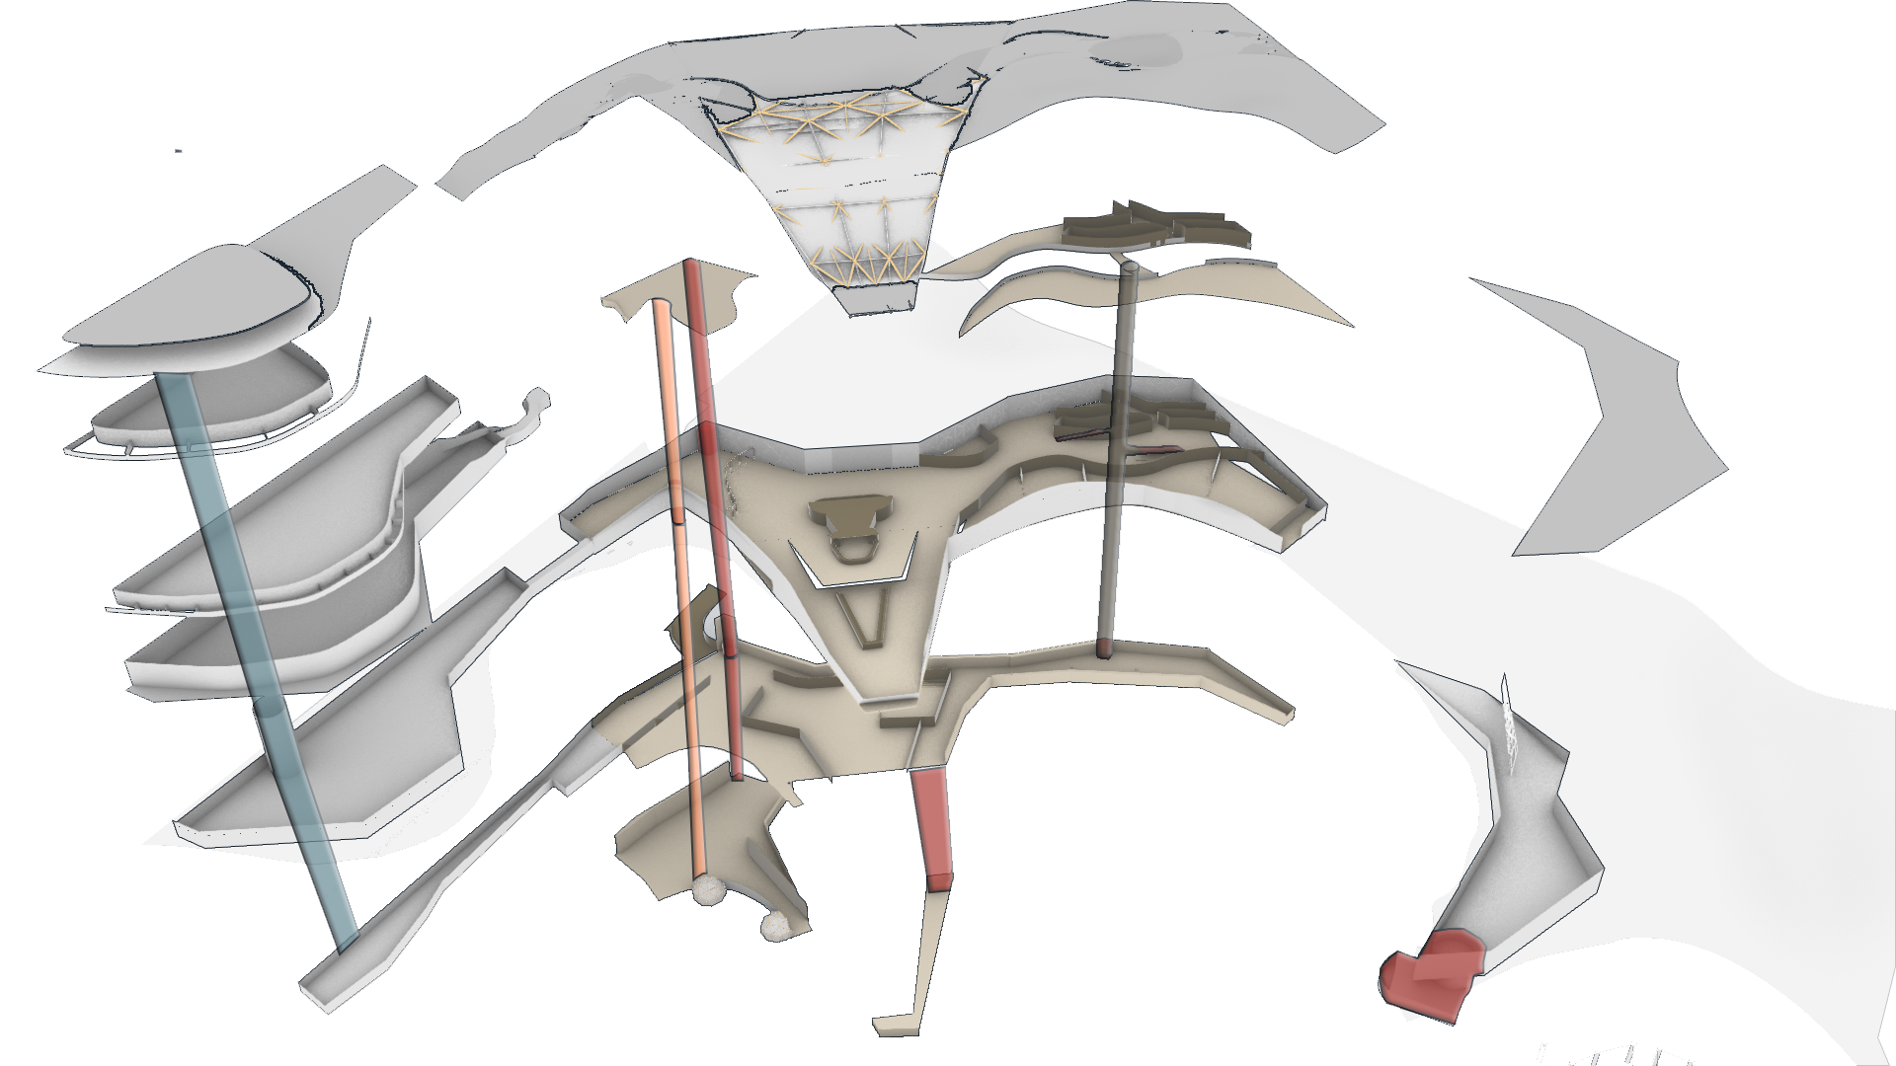
Vertical
Circulation

Slide 15
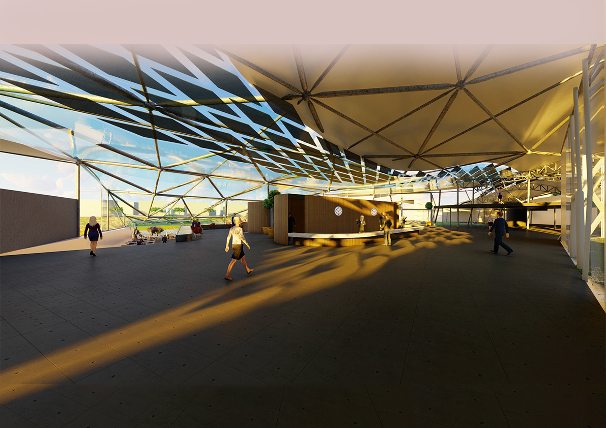
Lobby & Entrance

Slide 16
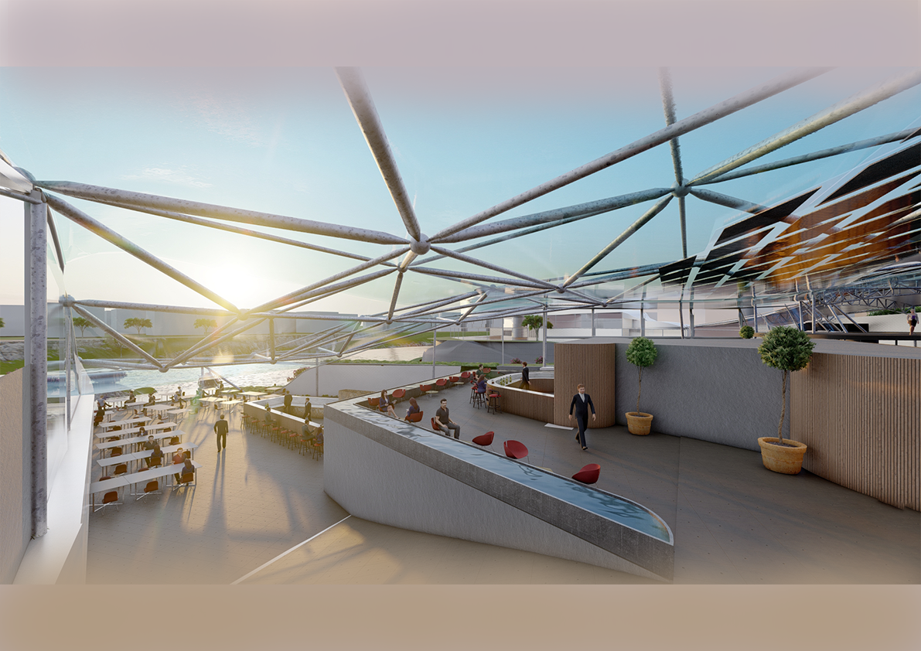
Dining Hall & Lobby Bar

Slide 17
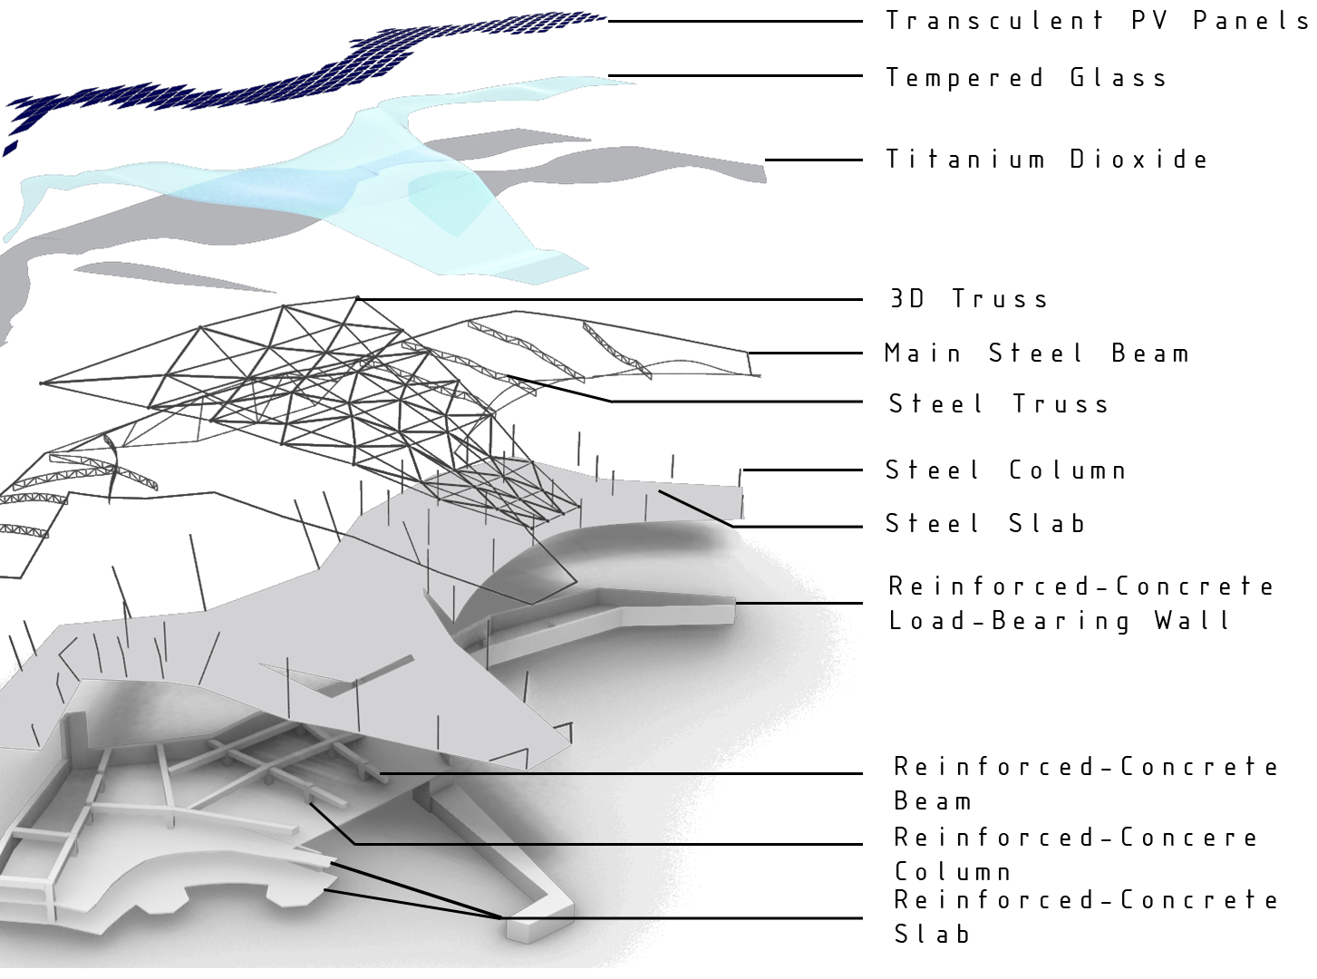

Slide 18
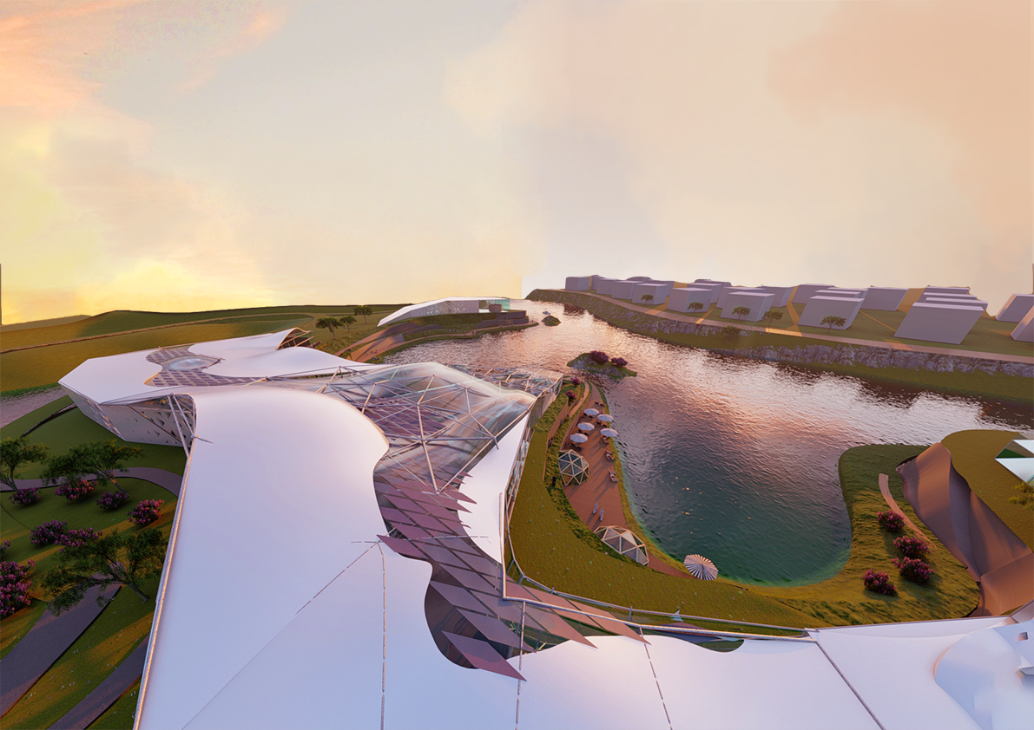

Slide 19
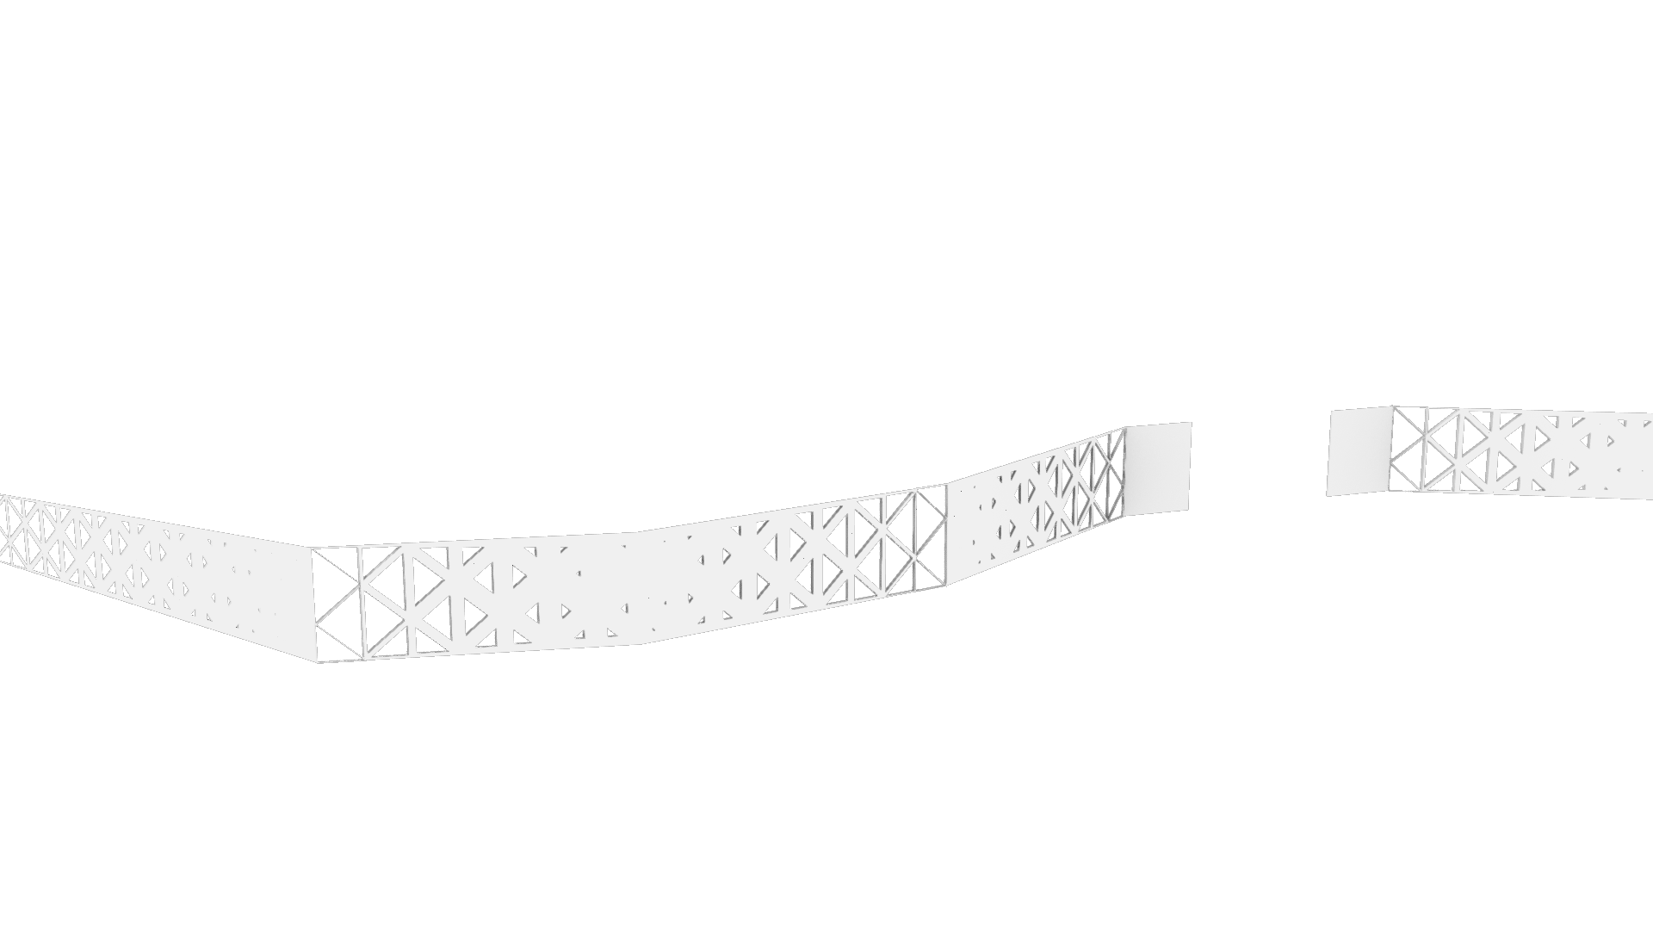
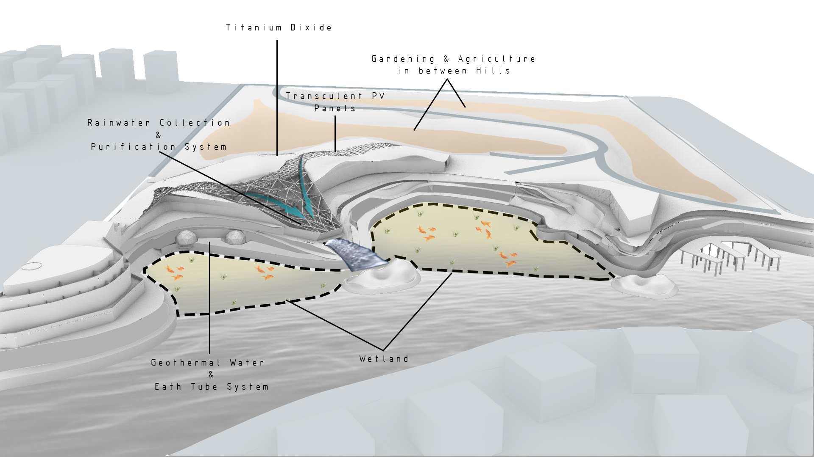
Titanium Dioxide Facade
Transculent PV
Panels
Environmental Systems

